Slide 1
Unit - II
Hypervisors

Slide 2
Agenda
Describing a hypervisor
Understanding the role of a hypervisor
Comparing today’s hypervisors

Slide 3
Describing a Hypervisor
The hypervisor is a layer of software that resides below the virtual machines and above the hardware which provides an environment for programs that are identical to original machine with minor decreases in execution speed together with complete control over resource allocation.
The hypervisor manages the interactions between each virtual machine and the hardware that the guests all share.
Initially, virtual machine monitors were used for the development and debugging of operating systems because they provided a sandbox for programmers to test rapidly and repeatedly, without using all of the resources of the hardware.
Added the ability to run multiple environments concurrently, carving the hardware resources into virtual servers that could each run its own operating system.

Slide 4
What are the design conditions that the hypervisor should satisfy?

Slide 5
“Classic” VM (Popek & Goldberg, 1974) (1/4)
Essentials of a Virtual Machine Monitor (VMM)
An efficient, isolated duplicate of the real machine.
Equivalence
Software on the VMM executes identically to its execution on hardware, barring timing effects.
i.e. Running on VMM == Running directly on HW
Performance
Non –Privileged instructions can be executed directly by the real processor, with no software intervention by the VMM.
i.e. Performance on VMM == Performance on HW
Resource control
The VMM must have complete control of the virtualized resources

Slide 6
“Classic” VM (Popek & Goldberg, 1974) (2/4)
Instruction types
Privileged instructions: generate trap when executed in any but the most-privileged level
Execute in privileged mode, trap in user mode
E.g. x86 LIDT : load interrupt descriptor table address
Privileged state: determines resource allocation
Privilege mode, addressing context, exception vectors, …
Sensitive instructions: instructions whose behavior depends on the current privilege level
Control sensitive: change privileged state
Behavior sensitive: exposes privileged state
E.g. x86 POPF : pop stack to EFLAGS (in user-mode, the ‘interrupt enable’ bit is not over-written)

Slide 7
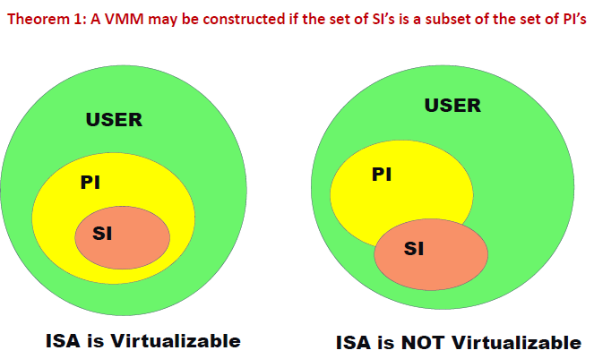
“Classic” VM (Popek & Goldberg, 1974) (3/4)

Slide 8
“Classic” VM (Popek & Goldberg, 1974) (4/4)
Resource control : To build a VMM, it is sufficient for all instructions that affect the correct functioning of the VMM (SI’s) always trap and pass control to the VMM.
Performance: Non-privileged instructions are executed without VMM intervention
Equivalence: We are not changing the original code, so the output will be the same.

Slide 9
Virtualization Theorem
Subset theorem :
For any conventional third-generation computer, a VMM may be constructed if the set of sensitive instructions for that computer is a subset of the set of privileged instructions.
Recursive Emulation :
A conventional third-generation computer is recursively virtualizable if
It is virtualizable
VMM without any timing dependencies can be constructed for it.
Under this theorem, x86 architecture cannot be virtualized directly. Other techniques are needed.

Slide 10
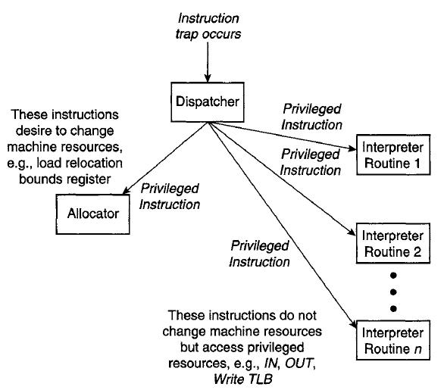
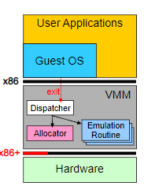
Components of a Virtual Machine Monitor

Slide 11
Dispatcher
Invoked by the interrupt handler when the hardware traps
Any instructions in a guest OS that attempt to change resource assignments or whose behavior is affected by the assignment of resources will trap to the VMM dispatcher.
Top-level control module of the VMM, which decides the next module to be invoked
Allocator
Invoked by the dispatcher whenever there is a need to change machine resources associated with some virtual machine
Trapping instructions that attempt to change resource assignments are then directed by the dispatcher to the allocator.
How to allocate memory resources in a non-conflicting manner.
Interpreter
Contains several Interpreter routines
one per privileged instruction,
emulate the effects of the instructions when operating on virtual resources. After an interpreter routine finishes, control is passed back to the guest

Slide 12
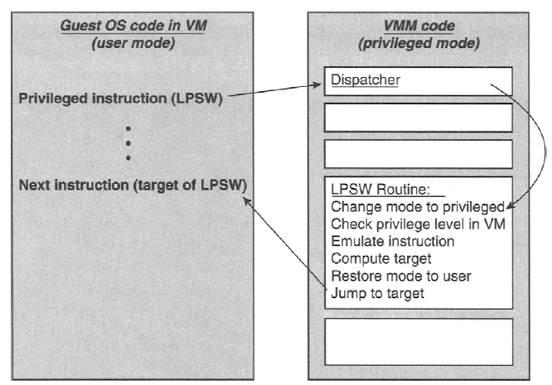
Handling Privileged Instruction in Guest OS by VMM

Slide 13
Resource Virtualization Techniques
Resources for virtualization
Processors
CPU Virtualization
Software Techniques
Trap and Emulate
Para Virtualization
Hardware Techniques
Hardware Assisted Virtualization
Memory
Software Techniques
Shadow Page Tables
Hardware Techniques
Extended Page Table
Storage
Software Techniques
Software RAID
Storage Area Network
Logical Volume Manager
Hardware Techniques
Hardware RAID
I/O
Software Techniques
I/O Emulation
Hardware Techniques
Intel VT-d

Slide 14
CPU Virtualization Software Techniques

Slide 15
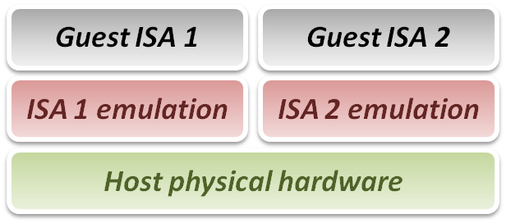
Three emulation implementations :
Interpretation
Emulator interprets only one instruction at a time.
Static Binary Translation
Emulator translates a block of guest binary at a time and further optimizes for repeated instruction executions.
Dynamic Binary Translation
This is a hybrid approach of emulator, which mix two approaches above.

Slide 16
Approach #1: Hosted Interpretation
Run the VMM as regular user application atop of host OS
VMM maintains a software-level representation of physical hardware
Interpreter execution flow :
Fetch one guest instruction from guest memory image.
Decode and dispatch to corresponding emulation unit.
Execute the functionality of that instruction and modify some related system states, such as simulated register values.
Increase the guest PC (Program Counter register) and then repeat this process again.

Slide 17
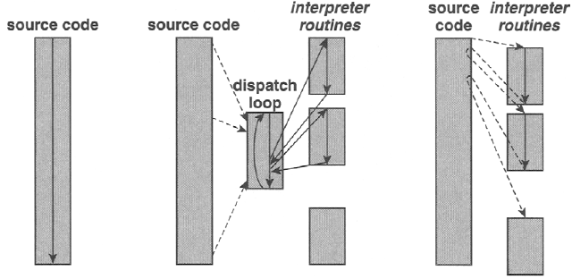
Interpretation
(a) Native execution (b) decode-and-dispatch interpretation (c) threaded interpretation

Slide 18
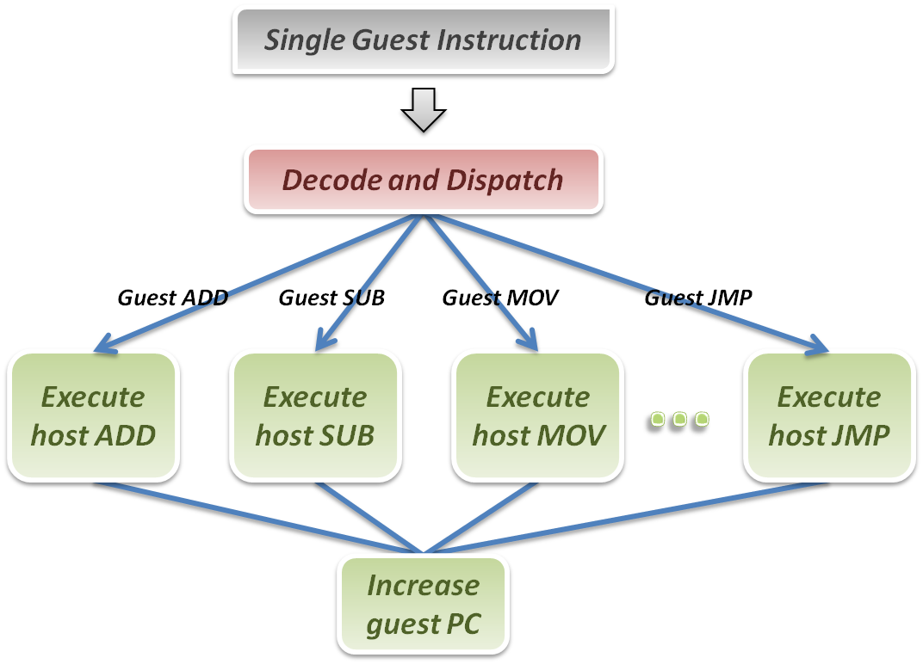
Interpreter

Slide 19
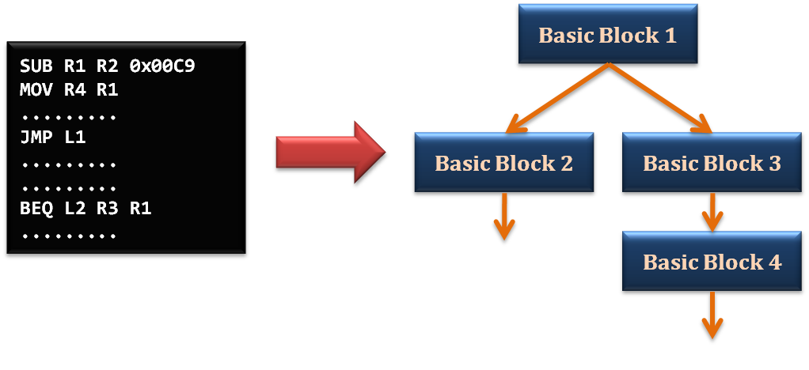
Static Binary Translation
Using the concept of basic block which comes from compiler optimization technique.
A basic block is a portion of the code within a program with certain desirable properties that make it highly amenable to analysis.
A basic block has only one entry point, meaning no code within it is the destination of a jump instruction anywhere in the program.
A basic block has only one exit point, meaning only the last instruction can cause the program to begin executing code in a different basic block.

Slide 20
Static binary translation flow :
Fetch one block of guest instructions from guest memory image.
Decode and dispatch each instruction to the corresponding translation unit.
Translate guest instruction to host instructions.
Write the translated host instructions to code cache.
Execute the translated host instruction block in code cache.

Slide 21
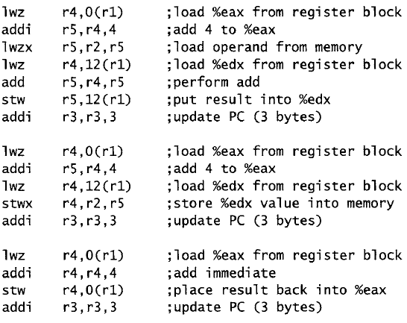
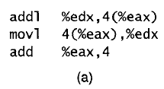
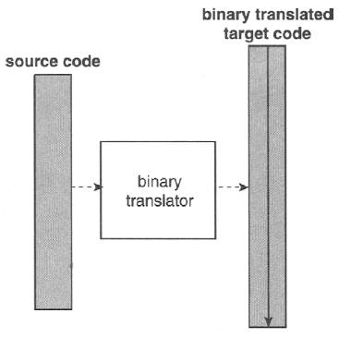
Binary Translation

Slide 22
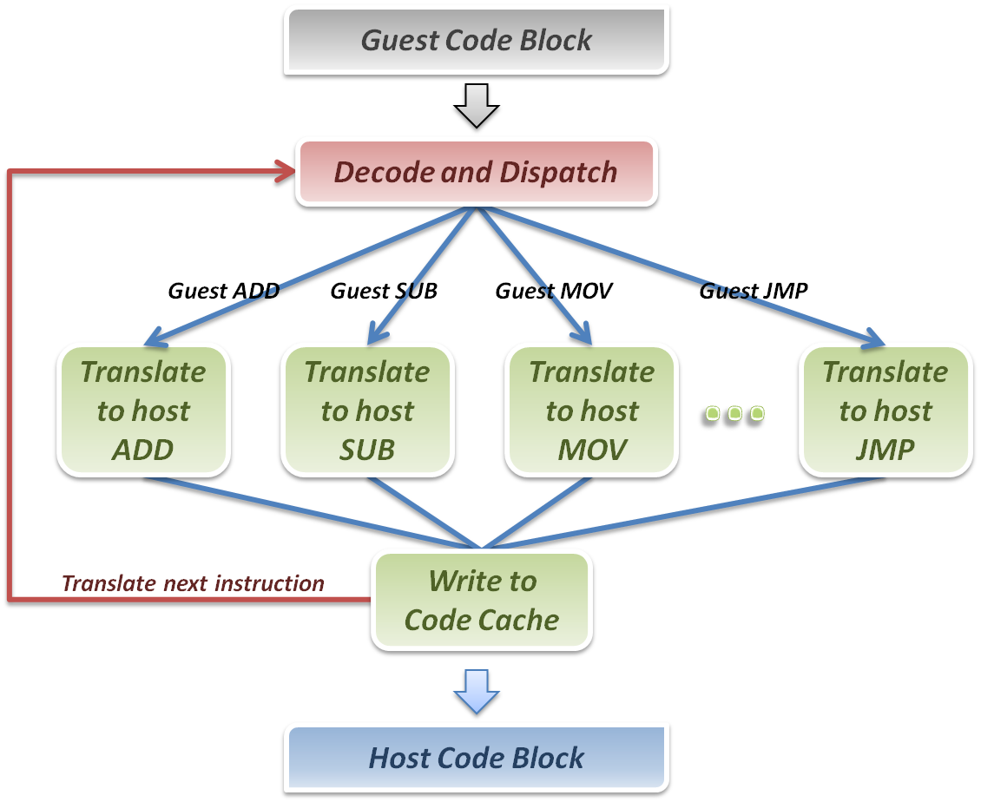
Binary Translator

Slide 23
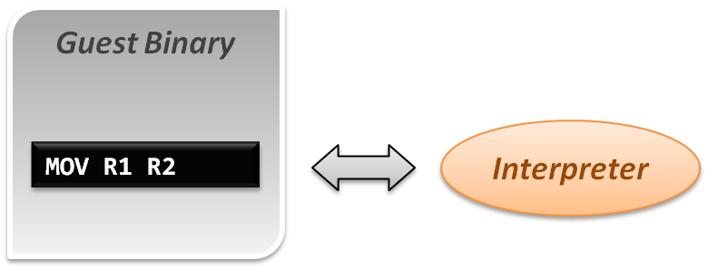
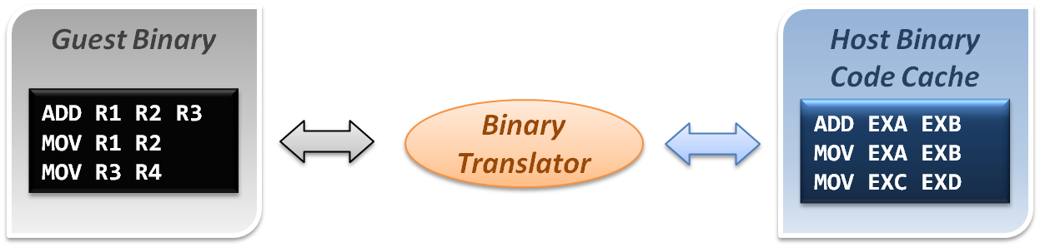
Comparison
Interpretation implementation
Static binary translation implementation

Slide 24
Dynamic Binary Translation
First time execution, no translated code in code cache.
Miss code cache matching, then directly interpret the guest instruction.
As a code block discovered, trigger the binary translation module.
Translate guest code block to host binary, and place it in the code cache.
Next time execution, run the translated code clock in the code cache.
Binary Translator
Guest Binary
trigger
Host Binary Code Cache
Emulation Manager
hit
exit
return
miss
Interpreter

Slide 25
CPU Architecture
What is trap ?
When CPU is running in user mode, some internal or external events, which need to be handled in kernel mode, take place.
Then CPU will jump to hardware exception handler vector, and execute system operations in kernel mode.
Trap types :
System Call
Invoked by application in user mode.
For example, application ask OS for system IO.
Hardware Interrupts
Invoked by some hardware events in any mode.
For example, hardware clock timer trigger event.
Exception
Invoked when unexpected error or system malfunction occur.
For example, execute privilege instructions in user mode.

Slide 26
Approach #2: Direct Execution with Trap and Emulation
This approach requires that a processor be “virtualizable”
Privileged instructions cause a trap when executed in Rings 1—3
Sensitive instructions access low-level machine state that should be managed by an OS or VMM
Ex: Instructions that modify segment/page table registers
Ex: IO instructions
Virtualizable processor: all sensitive instructions are privileged
If a processor is virtualizable, a VMM can interpose on any sensitive instruction that the VM tries to execute
VMM can control how the VM interacts with the “outside world” (i.e., physical hardware)
VMM can fool the guest OS into thinking that guest OS runs at the highest privilege level (e.g., if guest OS invokes sensitive instruction to check the current privilege level)

Slide 27
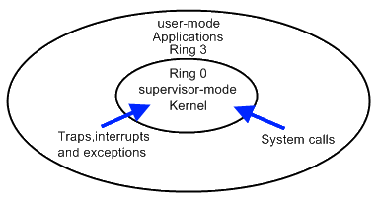
Trap and Emulate Model
VMM virtualization paradigm (trap and emulate) :
Let normal instructions of guest OS run directly on processor in user mode.
When executing privileged instructions, hardware will make processor trap into the VMM.
The VMM emulates the effect of the privileged instructions for the guest OS and return to guest.

Slide 28
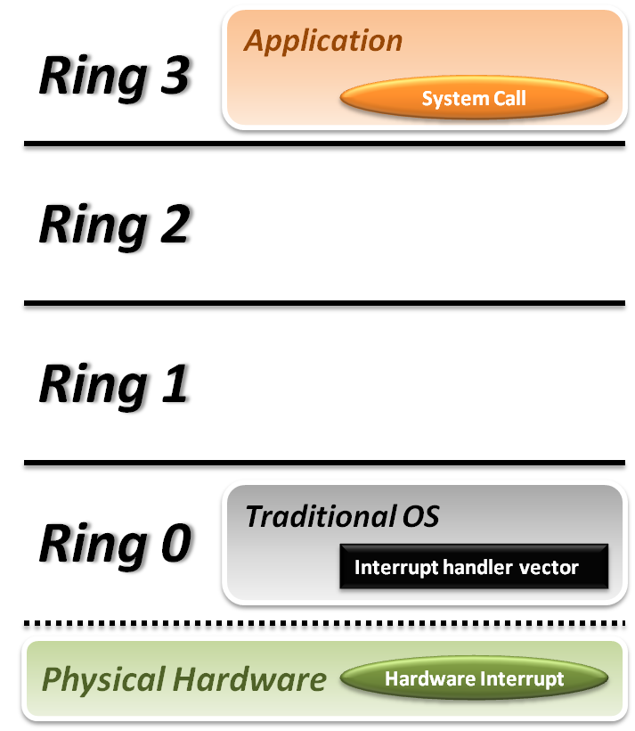


Trap and Emulate Model
Traditional OS :
When application invoke a system call :
CPU will trap to interrupt handler vector in OS.
CPU will switch to kernel mode (Ring 0) and execute OS instructions.
When hardware event :
Hardware will interrupt CPU execution, and jump to interrupt handler in OS.

Slide 29
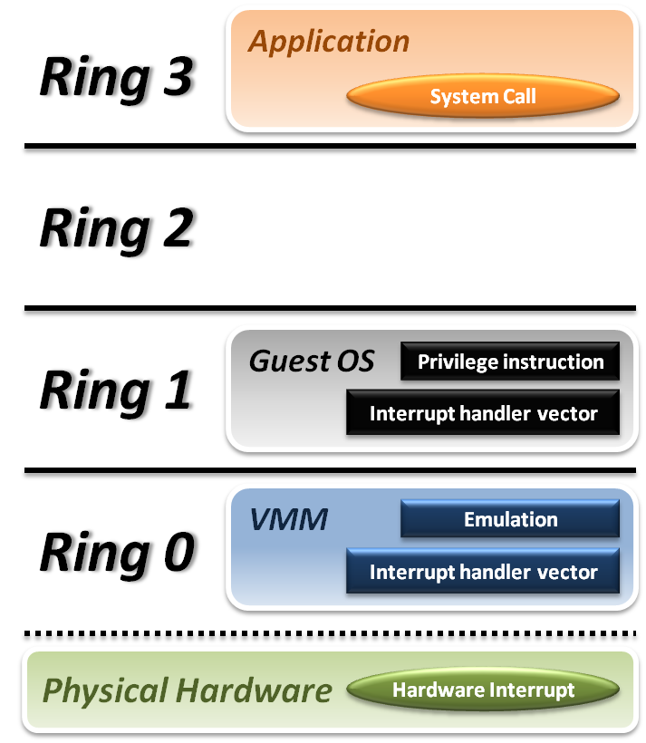






Trap and Emulate Model
VMM and Guest OS :
System Call
CPU will trap to interrupt handler vector of VMM.
VMM jump back into guest OS.
Hardware Interrupt
Hardware make CPU trap to interrupt handler of VMM.
VMM jump to corresponding interrupt handler of guest OS.
Privilege Instruction
Running privilege instructions in guest OS will be trapped to VMM for instruction emulation.
After emulation, VMM jump back to guest OS.

Slide 30
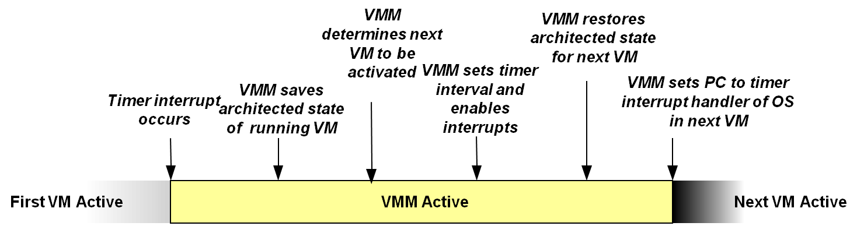
Context Switch
Steps of VMM switch different virtual machines :
Timer Interrupt in running VM.
Context switch to VMM.
VMM saves state of running VM.
VMM determines next VM to execute.
VMM sets timer interrupt.
VMM restores state of next VM.
VMM sets PC to timer interrupt handler of next VM.
Next VM active.

Slide 31
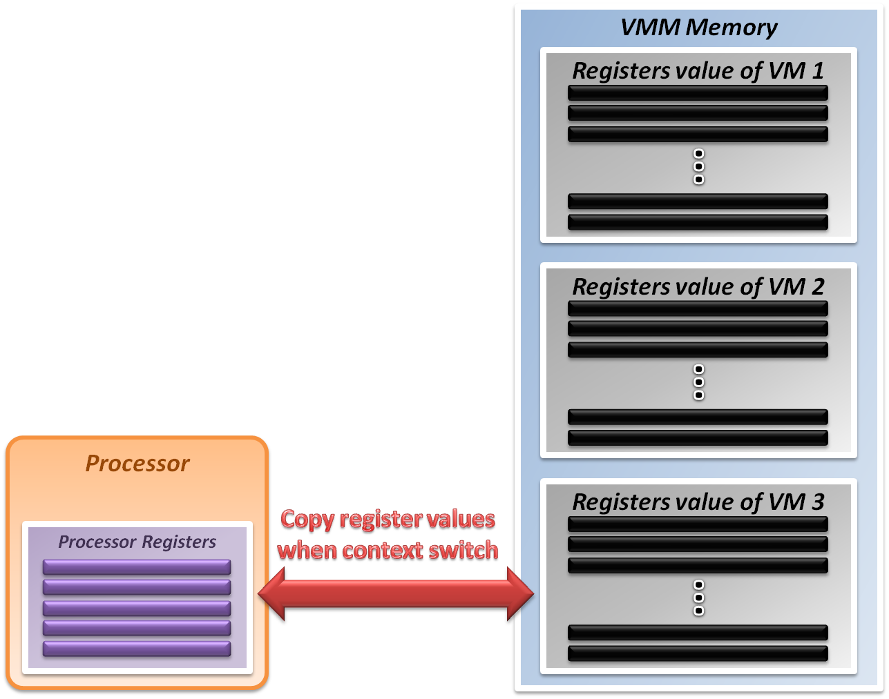
System State Management
Virtualizing system state :
VMM will hold the system states of all virtual machines in memory.
When VMM context switch from one virtual machine to another
Write the register values back to memory
Copy the register values of next guest OS to CPU registers.

Slide 32
Paravirtualization!
Does not run unmodified guest OSes
Requires guest OS to “know” it is running on top of a hypervisor
E.g., instead of doing cli to turn off interrupts, guest OS should do hypercall(DISABLE_INTERRUPTS)

Slide 33
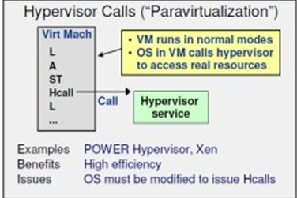
Continued …
Pros:
No hardware support required
Performance – better than emulation
Con:
Requires specifically modified guest
Same guest OS cannot run in the VM and bare-metal
Example hypervisor: Xen

Slide 34


Hardware Technique - VTx
Two new VT-x operating modes
Less-privileged mode (VMX non-root) for guest OSes
More-privileged mode (VMX root) for VMM
Two new transitions
VM entry to non-root operation
VM exit to root operation
Virtual Machines (VMs)
Ring 3
Apps
Apps
Ring 0
OS
OS
VM Exit
VM Entry
VMX Root
VM Monitor (VMM)
Execution controls determine when exits occur
Access to privilege state, occurrence of exceptions, etc.
Flexibility provided to minimize unwanted exits
VM Control Structure (VMCS) controls VT-x operation
Also holds guest and host state

Slide 35
CPU Hardware Virtualization Techniques

Slide 36
Intel VT-x
In order to straighten those problems out, Intel introduces one more operation mode of x86 architecture.
VMX Root Operation (Root Mode)
All instruction behaviors in this mode are no different to traditional ones.
All legacy software can run in this mode correctly.
VMM should run in this mode and control all system resources.
VMX Non-Root Operation (Non-Root Mode)
All sensitive instruction behaviors in this mode are redefined.
The sensitive instructions will trap to Root Mode.
Guest OS should run in this mode and be fully virtualized through typical “trap and emulation model”.

Slide 37
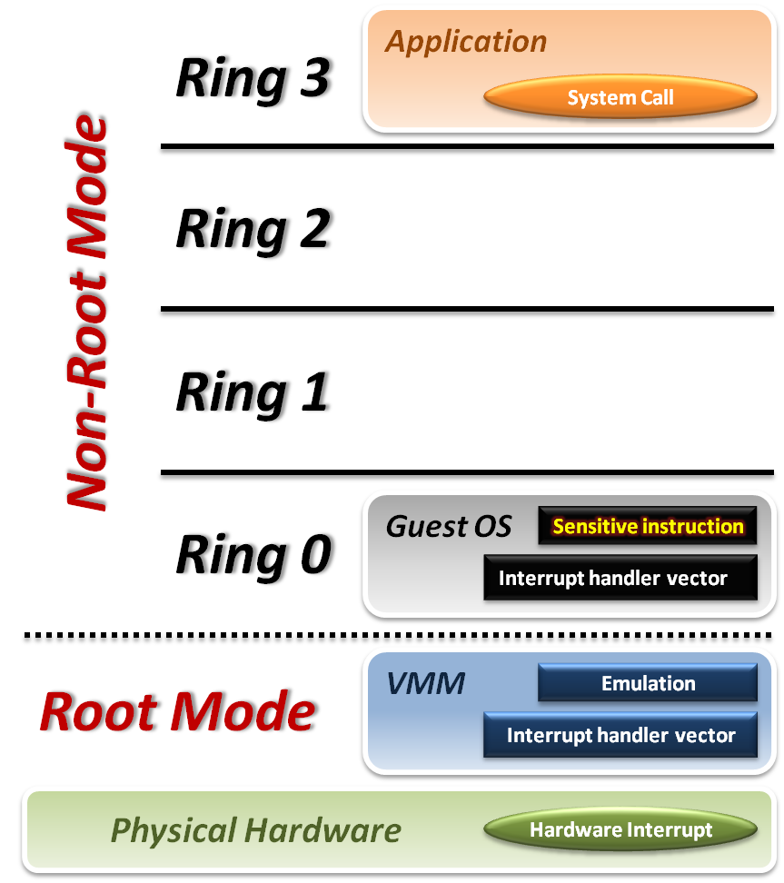





Intel VT-x
VMM with VT-x :
System Call
CPU will directly trap to interrupt handler vector of guest OS.
Hardware Interrupt
Still, hardware events need to be handled by VMM first.
Sensitive Instruction
Instead of trap all privilege instructions, running guest OS in Non-root mode will trap sensitive instruction only.

Slide 38
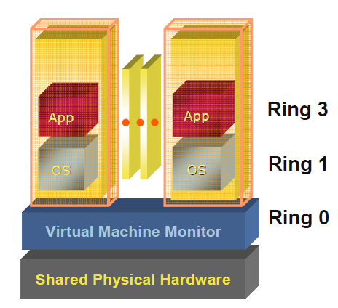
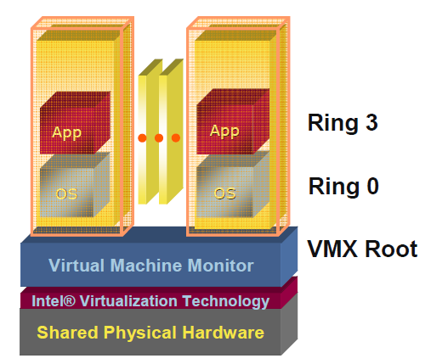
Pre & Post Intel VT-x
VMM de-privileges the guest OS into Ring 1, and takes up Ring 0
OS un-aware it is not running in traditional ring 0 privilege
Requires compute intensive SW translation to mitigate
VMM has its own privileged level
where it executes
No need to de-privilege the guest OS
OSes run directly on the hardware

Slide 39
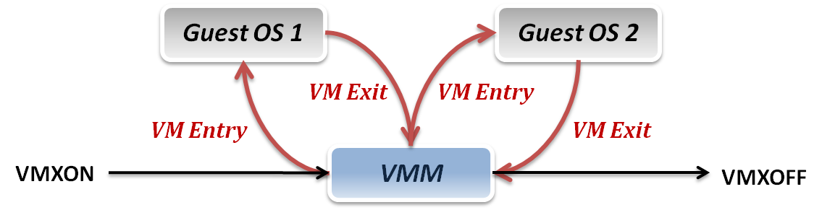
Context Switch
VMM switch different virtual machines with Intel VT-x :
VMXON/VMXOFF
These two instructions are used to turn on/off CPU Root Mode.
VM Entry
This is usually caused by the execution of VMLAUNCH/VMRESUME instructions, which will switch CPU mode from Root Mode to Non-Root Mode.
VM Exit
This may be caused by many reasons, such as hardware interrupts or sensitive instruction executions.
Switch CPU mode from Non-Root Mode to Root Mode.

Slide 40
System State Management
Intel introduces a more efficient hardware approach for register switching, VMCS (Virtual Machine Control Structure) :
State Area
Store host OS system state when VM-Entry.
Store guest OS system state when VM-Exit.
Control Area
Control instruction behaviors in Non-Root Mode.
Control VM-Entry and VM-Exit process.
Exit Information
Provide the VM-Exit reason and some hardware information.
Whenever VM Entry or VM Exit occur, CPU will automatically read or write corresponding information into VMCS.

Slide 41
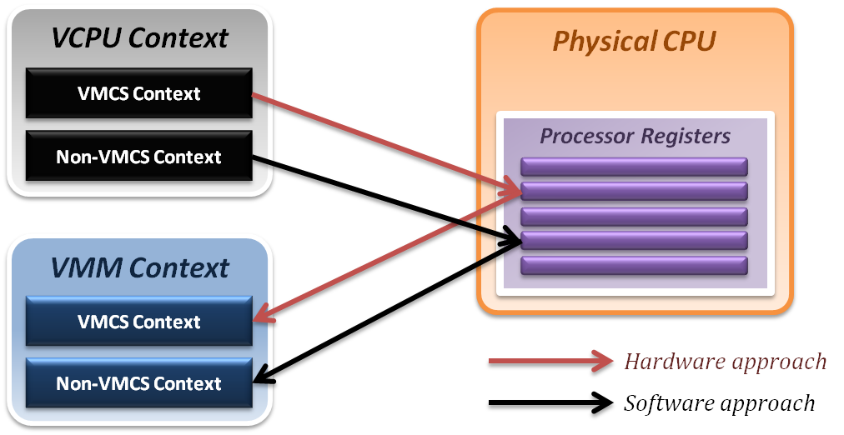
System State Management
Binding virtual machine to virtual CPU
VCPU (Virtual CPU) contains two parts
VMCS maintains virtual system states, which is approached by hardware.
Non-VMCS maintains other non-essential system information, which is approach by software.
VMM needs to handle Non-VMCS part.

Slide 43
Memory Virtualization

Slide 44
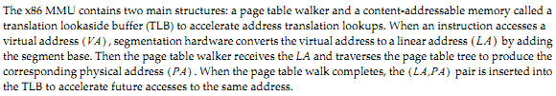
X86 Memory Access

Slide 45
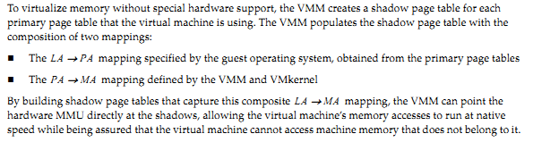
1. Shadow Page Tables

Slide 46
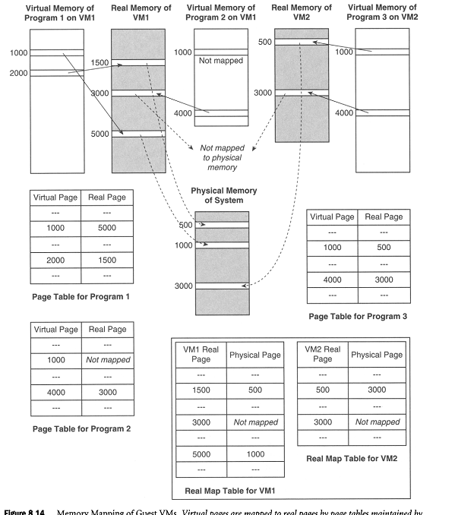

Slide 47
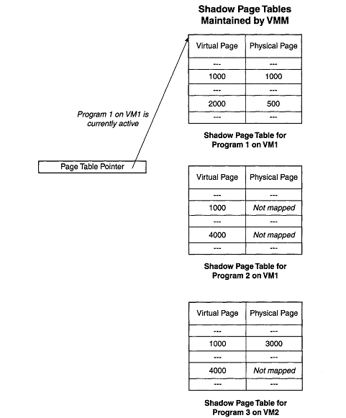
Shadow Page Table

Slide 48
Hardware Solution
Difficulties of shadow page table technique :
Shadow page table implementation is extremely complex.
Page fault mechanism and synchronization issues are critical.
Host memory space overhead is considerable.
But why we need this technique to virtualize MMU ?
MMU do not first implemented for virtualization.
MMU is knowing nothing about two level page address translation.
Now, let us consider hardware solution.

Slide 49
Extended Page Table
Concept of Extended Page Table (EPT) :
Instead of walking along with only one page table hierarchy, EPT technique implement one more page table hierarchy.
One page table is maintained by guest OS, which is used to generate guest physical address.
The other page table is maintained by VMM, which is used to map guest physical address to host physical address.
For each memory access operation, EPT MMU will directly get guest physical address from guest page table, and then get host physical address by the VMM mapping table automatically.

Slide 50

Extended Page Tables

Slide 51
Continued …
CR3
EPT Base Pointer (EPTP)
Guest IA-32
Page
Tables
Guest Physical Address
Extended
Page
Tables
Host Physical Address
Guest Linear Address
Extended Page Table
A new page-table structure, under the control of the VMM
Defines mapping between guest- and host-physical addresses
EPT base pointer (new VMCS field) points to the EPT page tables
EPT (optionally) activated on VM entry, deactivated on VM exit
Guest has full control over its own IA-32 page tables
No VM exits due to guest page faults, INVLPG, or CR3 changes

Slide 52
Continued …
All guest-physical memory addresses go through EPT tables
(CR3, PDE, PTE, etc.)
Above example is for 2-level table for 32-bit address space
Translation possible for other page-table formats (e.g., PAE)

Slide 53
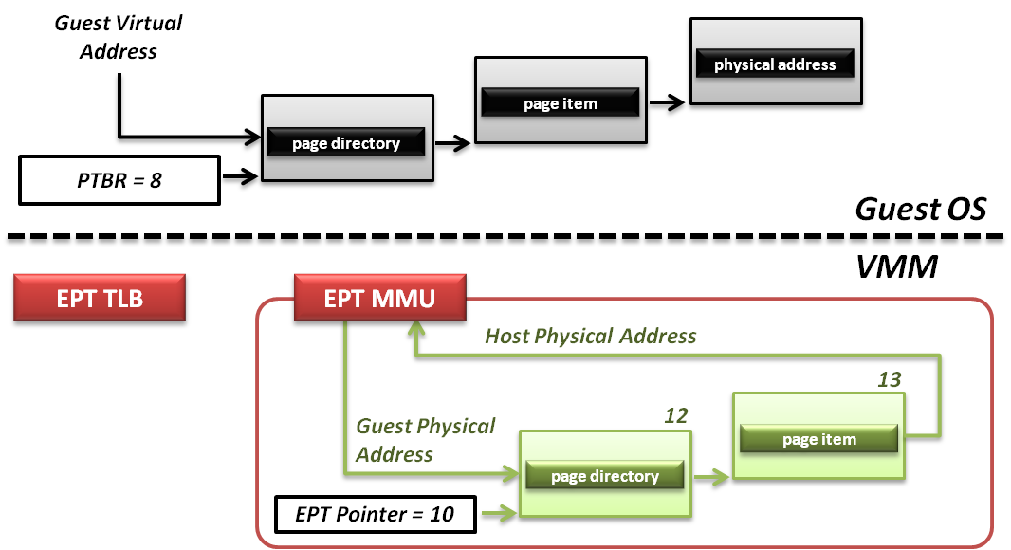
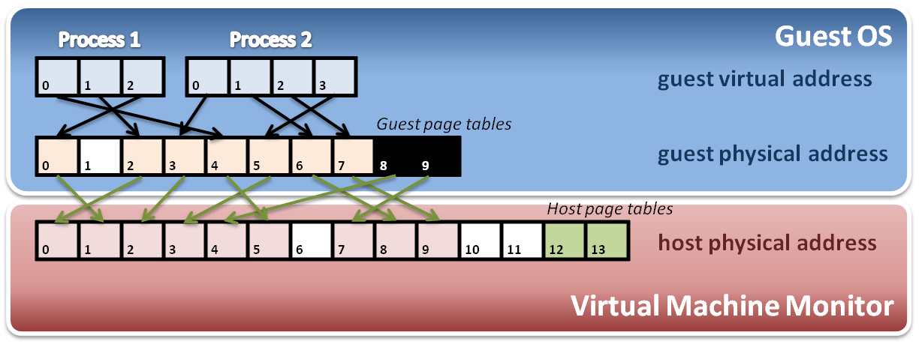
Memory Operation
6
8
9
7
8
4
Data

Slide 54
Hardware Solution
Difficulties of shadow page table technique :
Shadow page table implementation is extremely complex.
Page fault mechanism and synchronization issues are critical.
Host memory space overhead is considerable.
But why we need this technique to virtualize MMU ?
MMU do not first implemented for virtualization.
MMU is knowing nothing about two level page address translation.
Now, let us consider hardware solution.

Slide 55
Extended Page Table
Concept of Extended Page Table (EPT) :
Instead of walking along with only one page table hierarchy, EPT technique implement one more page table hierarchy.
One page table is maintained by guest OS, which is used to generate guest physical address.
The other page table is maintained by VMM, which is used to map guest physical address to host physical address.
For each memory access operation, EPT MMU will directly get guest physical address from guest page table, and then get host physical address by the VMM mapping table automatically.

Slide 56
I/O Virtualization

Slide 57
Continued …
Monolithic Model
Service VM Model
Pass-through Model
Service VMs
Guest VMs
VM₀
VM_{n}
VM₀
VM_{n}
I/O Services
VM_{n}
Guest OS
and Apps
Guest OS
and Apps
Guest OS
and Apps
Guest OS
and Apps
VM₀
Hypervisor
Device Drivers
Guest OS
and Apps
Device Drivers
Device Drivers
I/O Services
Device Drivers
Hypervisor
Hypervisor
Shared Devices
Shared Devices
Assigned Devices
Pro: Higher Performance
Pro: I/O Device Sharing
Pro: VM Migration
Con: Larger Hypervisor
Pro: High Security
Pro: I/O Device Sharing
Pro: VM Migration
Con: Lower Performance
Pro: Highest Performance
Pro: Smaller Hypervisor
Pro: Device assisted sharing
Con: Migration Challenges
VT-d Goal: Support all Models

Slide 60
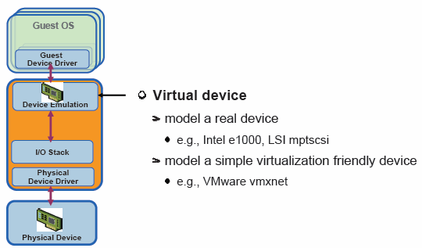

Slide 62
Packet Receive in Virtualized I/O

Slide 63
Packet Receive in Pass through I/O

Slide 64
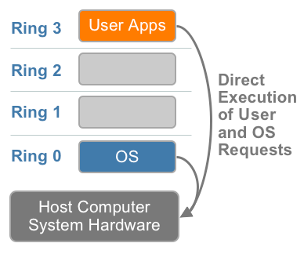
x86 Hardware Virtualization
The x86 architecture offers four levels of privilege known as Ring 0, 1, 2 and 3 to operating systems and applications to manage access to the computer hardware. While user level applications typically run in Ring 3, the operating system needs to have direct access to the memory and hardware and must execute its privileged instructions in Ring 0.
x86 privilege level architecture without virtualization
Notes:
Virtualizing the x86
architecture requires placing a virtualization layer under
the operating system (which expects to be in the
most privileged Ring 0) to create and manage the
virtual machines that deliver shared resources.
Further complicating the situation, some sensitive
instructions can’t effectively be virtualized as they have different semantics when they are not
executed in Ring 0. The difficulty in trapping and translating these sensitive and privileged
instruction requests at runtime was the challenge that originally made x86 architecture
virtualization look impossible.

Slide 65
Technique 1: Full Virtualization using Binary Translation
This approach relies on binary translation to trap (into the VMM) and to virtualize certain sensitive and non-virtualizable instructions with new sequences of instructions that have the intended effect on the virtual hardware. Meanwhile, user level code is directly executed on the processor for high performance virtualization.
Binary translation approach to x86 virtualization
Notes:
Each virtual machine monitor provides each Virtual Machine with all the services of the physical system, including a virtual BIOS, virtual devices and virtualized memory management.
In the traditional x86 architecture, operating system kernels expect direct CPU access running in Ring 0, which is the most privileged level. With software virtualization, guest operating systems cannot run in Ring 0 because the VMM sits there. The guest operating systems must therefore run in Ring 1, but there's a catch: Some x86 instructions work only in Ring 0, so the operating systems must be recompiled to avoid them. This process is called paravirtualization, and it is impractical — especially if the source code for the OS is not available. To get around this, VMMs traps these instructions and emulates them, which unfortunately results in an enormous performance hit: Virtual machines can be significantly slower than real physical ones.
all of this needed to be virtualized: disk and network devices needed to be emulated, as did interrupts and timers, the motherboard and PCI buses, and so on. Guests needed to start in 16-bit mode and run a BIOS which loaded the guest kernel, which (again) ran in 16-bit mode, then bootstrapped its way up to 32-bit mode, and possibly then to 64-bit mode. All privileged instructions executed by the guest kernel needed to be emulated somehow; and the pagetables needed to be emulated in software.
This mode - where all of the aspects the virtual machine must be functionally identical to real hardware - is what I will call fully virtualized mode.

Slide 66
Full Virtualization using Binary Translation
This combination of binary translation and direct execution provides Full Virtualization as the guest OS is completely decoupled from the underlying hardware by the virtualization layer.
The guest OS is not aware it is being virtualized and requires no modification.
The hypervisor translates all operating system instructions at run-time on the fly and caches the results for future use, while user level instructions run unmodified at native speed.
VMware’s virtualization products such as VMWare ESXi and Microsoft Virtual Server are examples of full virtualization.
Notes:
Full virtualization is the only option that requires no hardware assist or operating system assist to virtualize sensitive and privileged instructions.

Slide 67
Full Virtualization using Binary Translation
The performance of full virtualization may not be ideal because it involves binary translation at run-time which is time consuming and can incur a large performance overhead.
The full virtualization of I/O – intensive applications can be a challenge.
Binary translation employs a code cache to store translated hot instructions to improve performance, but it increases the cost of memory usage.
The performance of full virtualization on the x86 architecture is typically 80% to 97% that of the host machine.
Notes:
Only operating systems running in ring 0 have unrestricted access to the hardware. By limiting this ring to use by a single OS, the processor enables the OS to have complete knowledge of the state of the hardware. For the VMM to work properly, it needs to run at ring 0 and create the illusion to the guest OS that the guest OS is running in ring 0. However, since the VMM is itself running in ring 0, no guest OS can run at this privilege level. In fact, today they typically run at ring 1-a technique known as “ring deprivileging.” This practice creates enormous difficulties for the VMM, which must constantly monitor the activities of the VMs to trap hardware accesses and certain system calls, executing them itself and emulating the results. Intel Virtualization Technology solves this problem by creating two classes of rings: the privileged “root” ring-referred to as ring 0P-for use by the VMM, and the deprivileged “non-root” ring-ring 0D-for the operating systems. In this way, the VMM can function as the fundamental layer and all OSs can run above it with the necessary benefits of ring 0. By use of this approach, hosted OSs and applications run within their expected ring levels and are unaware of the VMM-each hosted OS thinks it owns the entire machine.

Slide 68
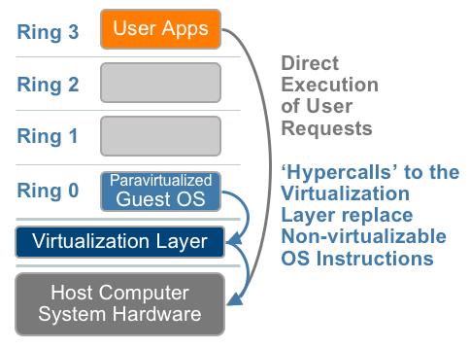
Technique 2: OS Assisted Virtualization or Paravirtualization (PV)
Paravirtualization refers to communication between the guest OS and the hypervisor to improve performance and efficiency.
Paravirtualization involves modifying the OS kernel to replace nonvirtualizable instructions with hypercalls that communicate directly with the virtualization layer hypervisor.
The hypervisor also provides hypercall
interfaces for other critical kernel
operations such as memory
management, interrupt
handling and time keeping.
Paravirtualization approach to x86 Virtualization
Notes:
In PV kernel is modified to send requests to XEN API on Dom0 and Dom0 executes the requests on cpu and then sends back to respective domu. CPU considers that request came from DOM0 and does not even know about virtualization. That is why PV does not require any special CPU.
In HVM we do not need to modify the kernel and VM is given access to cpu directly. Still the VM stays virtualized but CPU does know which VM has sent the request. That is why special CPU with vtx or amd virtualization is required.
PV: CPU is dumb, VM is genius :p HVM: VM is dumb, CPU is genius
When the guest OS is modified, it can no longer run directly on the hardware directly.
A hypercall is to a hypervisor what a syscall is to a kernel. A hypercall is a software trap from a domain to the hypervisor, just as a syscall is a software trap from an application to the kernel. Domains will use hypercalls to request privileged operations like updating pagetables.

Slide 69
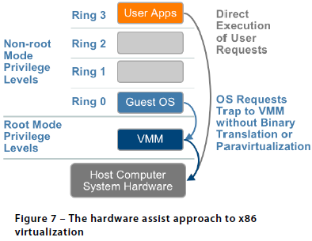
Technique 3: Hardware Assisted Virtualization (HVM)
Intel’s Virtualization Technology (VT-x) (e.g. Intel Xeon) and AMD’s AMD-V both target privileged instructions with a new CPU execution mode feature that allows the VMM to run in a new root mode below ring 0, also referred to as Ring 0P (for privileged root mode) while the Guest OS runs in Ring 0D (for de-privileged non-root mode).
Privileged and sensitive calls are
set to automatically trap to the
hypervisor and handled by
hardware, removing the need
for either binary translation or
para-virtualization.
Vmware only takes advantage
of these first generation
hardware features in limited
cases such as for 64-bit guest
support on Intel processors.
Notes:
It should be pointed out that full virtualization is not equal to HVM. Both of them can run VM without modifying the guest os. However, in full virtualization, VM's hardware is emulated by Qemu software. While HVM means the VM will run with hardware support. So, the performance in HVM will be better than that in full virtualization.
The guest state is stored in Virtual Machine Control Structures (VT-x) or Virtual Machine Control Blocks (AMD-V). Processors with Intel VT and AMD-V became available in 2006, so only newer systems contain these hardware assist features.
Due to high hypervisor to guest transition overhead and a rigid programming model, VMware’s binary translation approach currently outperforms first generation hardware assist implementations in most circumstances.
Second generation hardware assist technologies are in development that will have a greater impact on virtualization performance while reducing memory overhead. Both AMD and Intel have announced future development roadmaps, including hardware support for memory virtualization (AMD Nested Page Tables [NPT] and Intel Extended Page Tables [EPT]) as well as hardware support for device and I/O virtualization (Intel VT-d, AMD IOMMU).
Compute-intensive workloads already run well with binary translation of privileged instructions and direct execution of non-privileged instructions, but NPT/EPT will provide noticeable performance improvements for memory-remapping intensive workloads by removing the need for shadow page tables that consume system memory. Increased performance and reduced overhead expected in future CPUs will provide motivation to use hardware assist features much more broadly, but don’t expect revolutionary improvements. As processors get significantly faster each year, each year’s processor performance increases will likely have a greater impact on virtualization capacity and performance than future hardware assist optimizations.
Today's hardware platforms such as Intel's Ivy Bridge used in EC2's R3, C3, I2 instance types have very complete technology support for HVM including VT-d input/output memory management unit (IOMMU) and single-root I/O virtualization (SR-IOV) for PCI Express NICs (http://en.wikipedia.org/wiki/X86_virtualization). Basically, for memory access operations the IOMMU performs the guest-physical to host-physical translation in hardware instead of it being done in software by the hypervisor, making it far faster. In other words, due to virtualization support in IOMMU hardware, PV no longer provides the best performance.

Slide 70
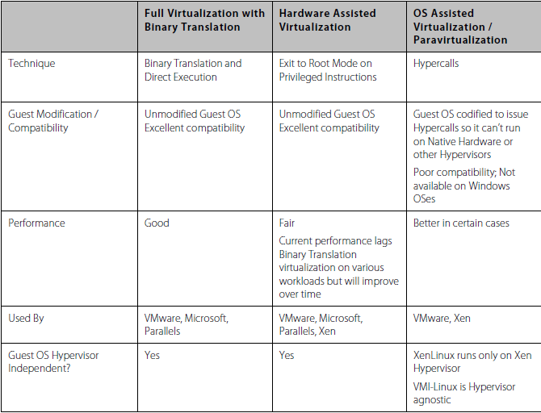
Summary Comparison of the Current State of x86 Virtualization Techniques
Notes:
The ability of the guest kernel to communicate directly with the hypervisor results in greater performance levels. Total virtualization, you’ll recall, inserts an entire hardware emulation layer between the guest operating system and the physical hardware. By contrast, paravirtualization’s thin software layer acts more like an air traffic controller for virtualized servers, allowing one guest OS access to the physical resources of the hardware while stopping all other guest OSs from accessing the same resources at the same time. This method is generally much more efficient than traditional hardware emulation virtualization The value proposition of paravirtualization is in lower virtualization overhead, but the performance advantage over full virtualization can vary greatly depending on the workload;
The second advantage of the paravirtualization approach compared to full virtualization is that paravirtualization does not limit you to the device drivers contained in the virtualization software; in fact, paravirtualization does not include any device drivers at all. Instead, it uses the device drivers contained in one of the guest operating systems, referred to as the privileged guest (Dom 0).

Slide 71
Full Virtualization vs. Paravirtualization
Paravirtualization is different from full virtualization, where the unmodified OS does not know it is virtualized and sensitive OS calls are trapped using binary translation at run time. In paravirtualization, these instructions are handled at compile time when the non-virtualizable OS instructions are replaced with hypercalls.
The advantage of paravirtualization is lower virtualization overhead, but the performance advantage of paravirtualization over full virtualization can vary greatly depending on the workload. Most user space workloads gain very little, and near native performance is not achieved for all workloads.
As paravirtualization cannot support unmodified operating systems (e.g. Windows 2000/XP), its compatibility and portability is poor.
Notes:
The ability of the guest kernel to communicate directly with the hypervisor results in greater performance levels. Total virtualization, you’ll recall, inserts an entire hardware emulation layer between the guest operating system and the physical hardware. By contrast, paravirtualization’s thin software layer acts more like an air traffic controller for virtualized servers, allowing one guest OS access to the physical resources of the hardware while stopping all other guest OSs from accessing the same resources at the same time. This method is generally much more efficient than traditional hardware emulation virtualization The value proposition of paravirtualization is in lower virtualization overhead, but the performance advantage over full virtualization can vary greatly depending on the workload;
The second advantage of the paravirtualization approach compared to full virtualization is that paravirtualization does not limit you to the device drivers contained in the virtualization software; in fact, paravirtualization does not include any device drivers at all. Instead, it uses the device drivers contained in one of the guest operating systems, referred to as the privileged guest.

